Slide 1
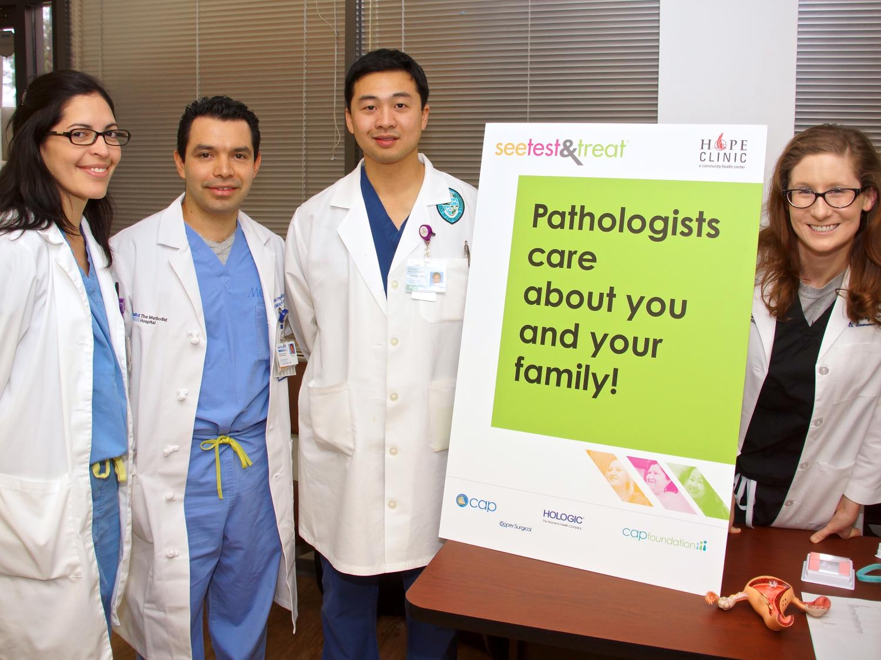

See, Test & Treat®
Case for Support

Slide 2
No woman in America should die from undiagnosed
cervical or breast cancer.
Notes:
We begin with our core conviction:
That no woman in America should die from undiagnosed cervical or breast cancer.
Because cervical cancer is preventable, and breast cancer can be treated when it is diagnosed early
Yet every year, thousands of American women discover these cancers too late.
The toll of these cancers falls most heavily on women with the least ability to manage and survive them:
The working mother who prioritizes her children’s healthcare at the expense of her own
The uninsured woman who can’t manage the cost of going to the doctor
The thousands of women who don’t have access to quality care in their home communities
When women don’t receive preventive care, what’s at stake is almost beyond measure—
the many years of quality life that these women deserve;
the vital roles they play in their families, communities and workplaces;
and the far higher costs of treating a cancer that is diagnosed too late.

Slide 3
Where Women’s Cancer
Risk Lives in America
African American women are
40%
more likely to die of breast cancer
Latina women are
60%
more likely to develop cervical cancer
Vietnamese American women are
5x
more likely to develop cervical cancer
Notes:
So where does the risk from these cancers live in America?
It’s concentrated in underserved communities both urban and rural,
where too many women live without regular health care,
which increases their risk for late diagnoses.
For instance,
African American women are 40 percent more likely to die of breast cancer, primarily as a result of late diagnoses
Latina women in America are 60 percent more likely to develop cervical cancer and 40 percent more likely to die from it
Cervical cancer incidence rates are five times higher among Vietnamese American women than White women.
[Source: Office of Minority Health, US Dept of Health and Human Services]

Slide 4
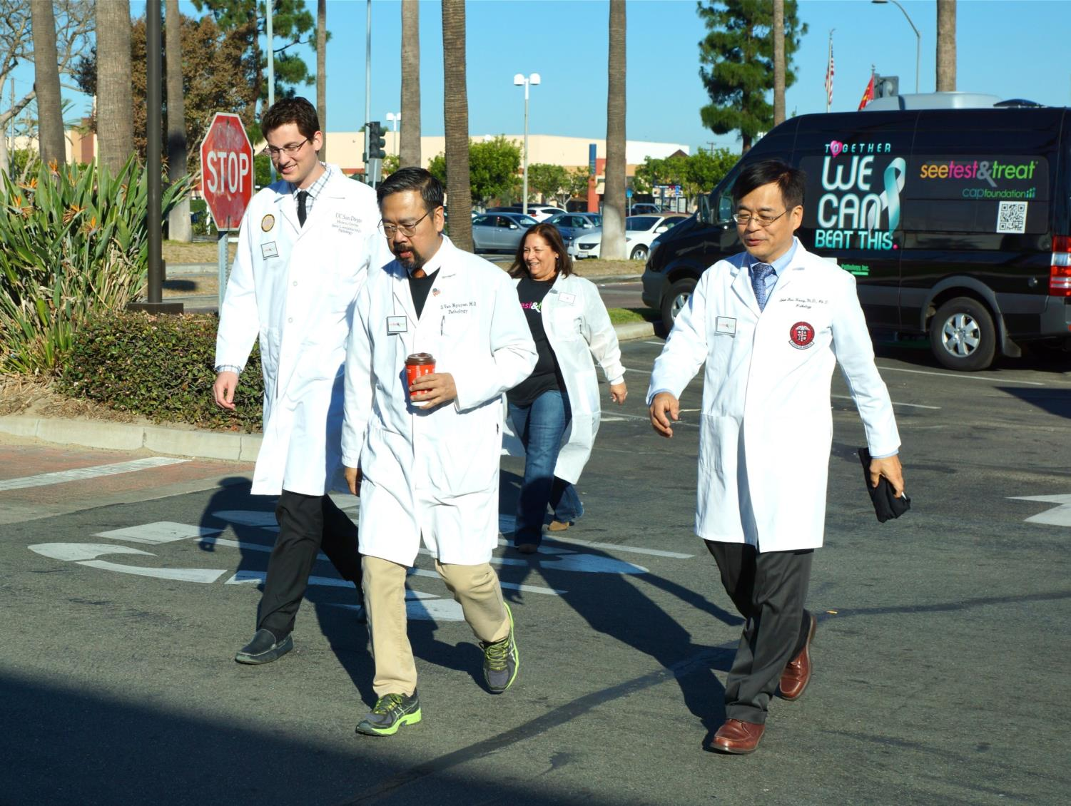
This is why America’s pathologists
created the See, Test & Treat program
Notes:
This is why America’s pathologists created the See, Test & Treat program,
organized through the CAP Foundation.

Slide 5
See, Test & Treat brings the
power of diagnostic medicine
to underserved communities
in order to
Save Women’s Lives from preventable cancers
Empower Families through preventive health care
Connect Communities with their health care providers
Notes:
See, Test & Treat is a free cancer screening and health education program
that brings the power of diagnostic medicine to underserved communities in order to:
Save Women’s Lives from preventable cancers
Empower Families through preventive health care
Connect Communities with their health care providers

Slide 6
See, Test & Treat has met the highest standards of quality and impact.
Now, it’s time to take this life-saving program
to the next level.
Notes:
In its first years of growth, See, Test & Treat has met the highest standards
of quality and impact across dozens of communities.
And it’s proven its ability to reach greater scale.
So now, it’s time to take this life-saving program to the next level
through the power of philanthropic investment.

Slide 7
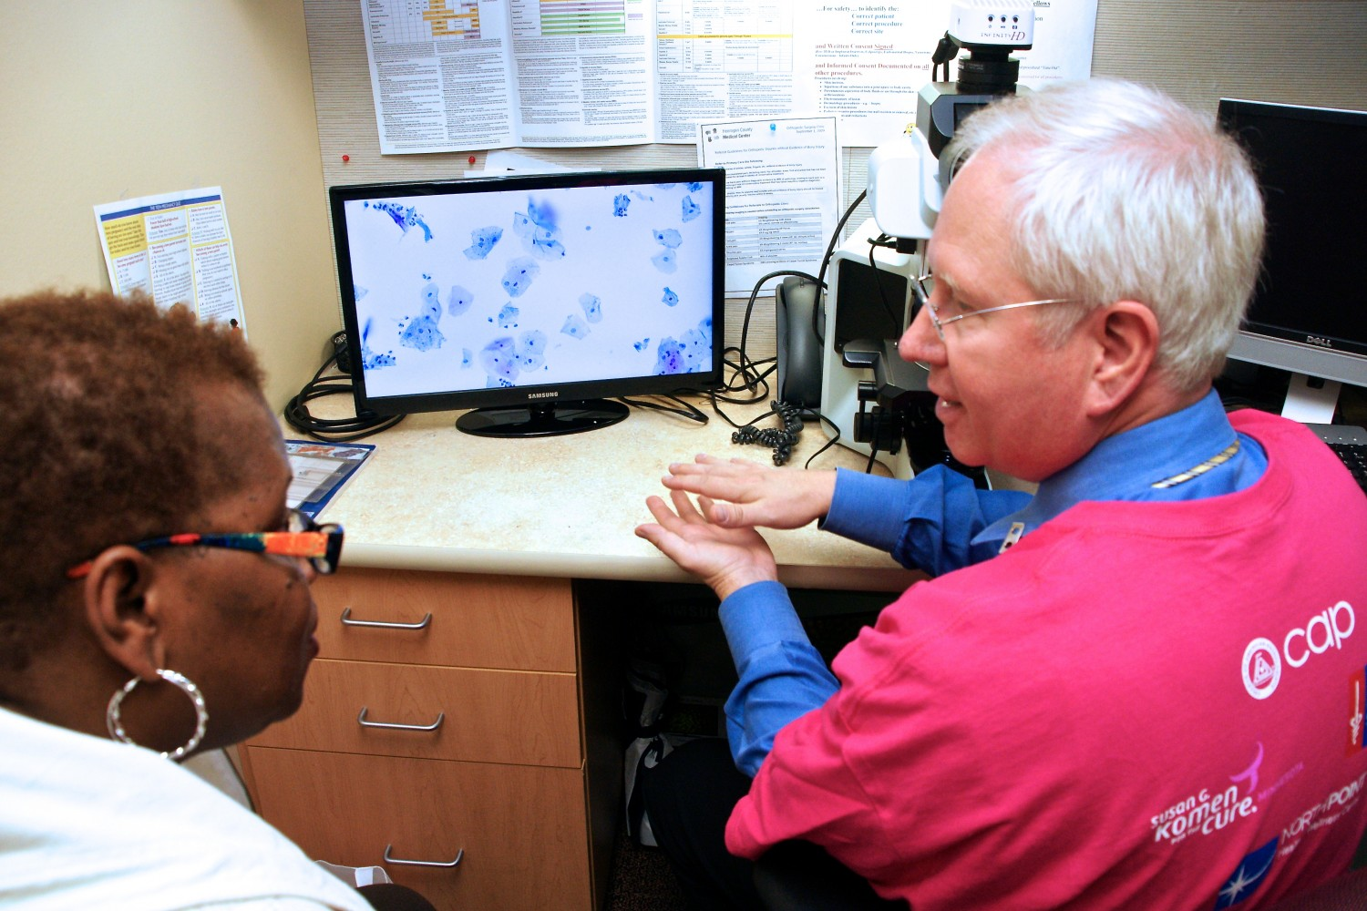
What is
See, Test & Treat?
Notes:
Let’s talk a little more about the program itself.
What is See, Test & Treat, and what makes it distinctive?

Slide 8
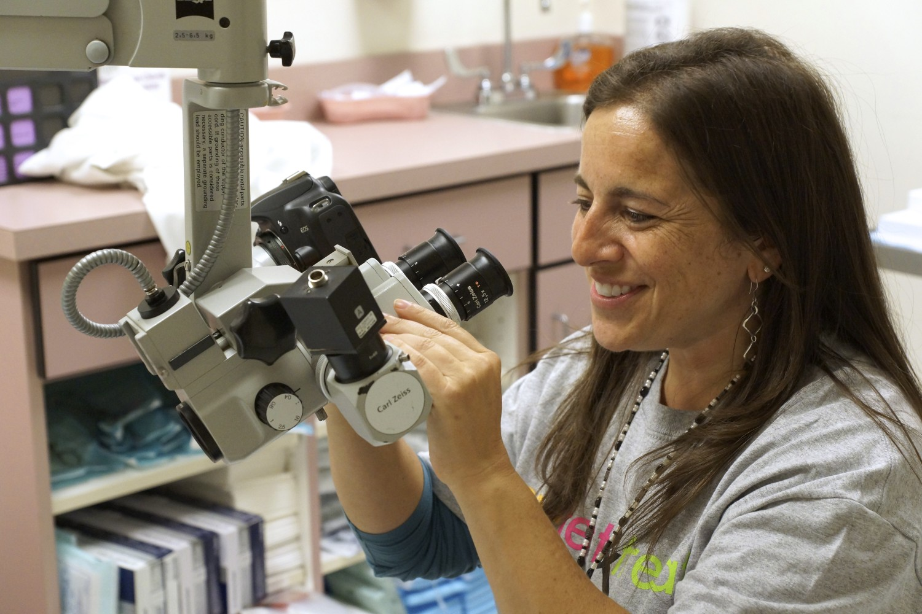
Every See, Test & Treat offers:
Cervical and breast cancer screening
Same-day results
50 – 150 Women
Follow-up care
Notes:
The core of every See, Test & Treat program is the same:
Every program offers both cervical and breast cancer screening.
Nearly all of the results are delivered on the same day, which removes one of the most important obstacles for the women we serve.
For a woman who works two jobs with inflexible schedules and has limited options for childcare, simply getting back to the hospital for a second visit to receive her test results can be a challenge.
Every See, Test & Treat takes place in a health care setting—a hospital or clinic—and that institution agrees to ensure follow-up care for all women who participate. So women with abnormal screening results schedule their next appointments on the same day.
Each program reaches between 50 and 150 women and families—
That’s large enough to deliver real impact and efficiency, yet small enough to ensure a dignified experience.
Which is an important thing for a group of women who may not have had a lot of positive experiences of our health care system.

Slide 9

Cervical and breast cancer screenings are just the beginning.
Diabetes education
Blood sugar testing
Dental services
Kidney function tests
Healthy cooking & nutrition
Blood pressure testing
Zumba & exercise
Health insurance enrollment
Benefits enrollment
Referrals
Notes:
So cervical and breast cancer screenings are the core of See, Test & Treat—but they’re also just the beginning.
Every See, Test & Treat includes additional health services that respond to the unique needs of its community.
These can include healthy cooking and nutrition classes, blood pressure and blood sugar testing, exercise classes and healthy living education.
Participants spend an entire day focusing on their health and wellbeing and connecting with resources in their community.

Slide 10
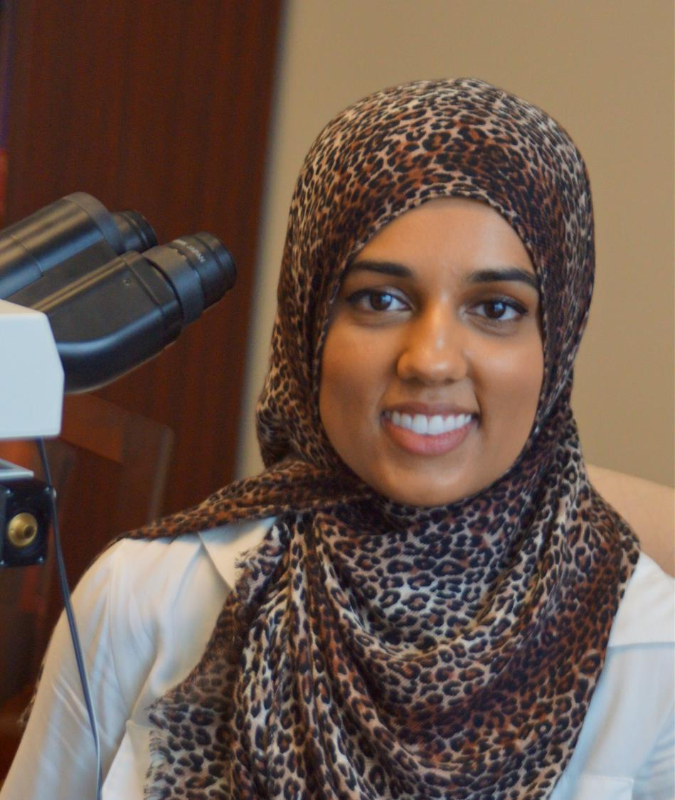
Empowering Women,
Celebrating Cultures
Interpreters
Translated Materials
Cultural Sensitivity
Community Outreach
Notes:
There’s one more way that See, Test & Treat is truly unique:
Each program is a community event that expresses the unique culture of the women and families who attend it.
Some have the feeling of a fiesta, others a sense of dignity with women in their Sunday best.
Each creates a welcoming environment that makes it much easier for women to say “yes” to attending.
We pay attention to details such as:
For many women whose first language is not English, See, Test & Treat provides skilled medical interpreters. In Houston, a recent program featured 20 languages in a single day.
We provide Translated materials for all attendees that explain important health concepts in their own language.
Every See, Test & Treat is tailored to the cultural expectations of its community—whether inviting husbands who accompany their wives to the doctor or simply providing appropriate food and festivities. In Minneapolis, the See, Test & Treat program has grown to three separate days for three distinct cultural communities—Hmong, Latina and African American.
And finally, community outreach: The pathologists who lead See, Test & Treat spend time in the communities they serve. In Minneapolis, Dr. Brad Linzie attends a Hmong community dinner and tea ceremony to build support and interest in the program.

Slide 11
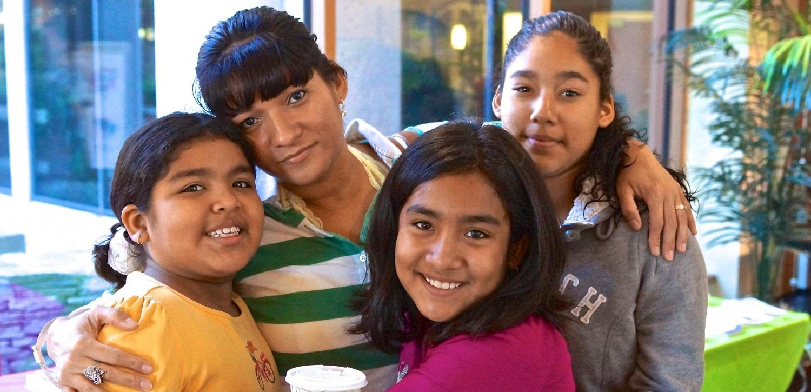
See, Test & Treat removes the barriers that stand between a woman and the preventative care she needs.
Lack of
Insurance
Finances
Time
Transportation
Health literacy
Language and Culture
Notes:
What it all adds up to is this:
See, Test & Treat removes the barriers that stand between a woman and the preventative care she needs.
Everything from lack of insurance and finances to the logistics of time and transportation to the broader gaps of health literacy, language and culture…
See, Test & Treat eliminates them all.

Slide 12

What’s the impact?
Notes:
So this is how See, Test & Treat works…
But what’s the impact?
Let’s take a look…

Slide 13
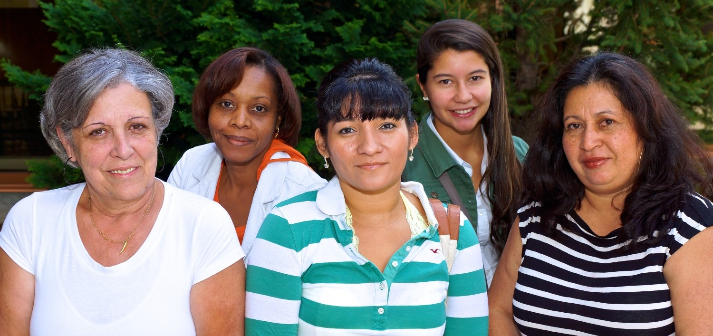
See, Test & Treat saves women’s lives from preventable cancers
Notes:
First and foremost, See, Test & Treat saves women’s lives from preventable cancers.
At every See, Test & Treat, women receive diagnoses that might otherwise wait until symptoms develop—possibly until it’s too late.

Slide 14
See, Test & Treat saves women’s lives from preventable cancers
9%
10%
Abnormal cervical results
Abnormal breast results
25%
Oral and Endometrial Cancers
Diabetes
Hypertension
HIV
Abnormal results in some communities
Also discovered
at See, Test & Treat
Notes:
On average, 9 percent of See, Test & Treat participants receive abnormal cervical screening results and 10 percent receive an abnormal breast screening diagnosis.
These numbers are higher than the American averages, which reflects the heightened risk in the communities we serve.
In some See, Test & Treat programs, they’ve reached as high as 25 percent.
Beyond the cervical and breast screenings, we also discover a wide range of other medical conditions at See, Test & Treat programs.
In just the last few years, women have discovered oral and endometrial cancers, diabetes, hypertension, and HIV through See, Test & Treat.

Slide 15
If you can engage women,
you can engage families.
Notes:
But saving women’s lives is just the beginning.
Because if you can engage women through health care, you can engage their entire families.

Slide 16
Women make approximately
80%
of health care decisions for their families
Notes:
That’s because women make approximately 80% of health care decisions for their families.

Slide 17
See, Test & Treat empowers families through preventive health care
1,500
friends, family
and community participants
761
women screened
Notes:
This is how See, Test & Treat empowers families through preventive health care.
For evidence of this multiplier effect, we need look no further than See, Test & Treat attendees themselves. In 2015, 761 women were screened through See, Test & Treat—and those women brought along 1,500 additional family, friends and community members to attend with them.
That means whole families are attending, learning about health care, and having an experience together that helps them encourage each other to make their health a priority.

Slide 18
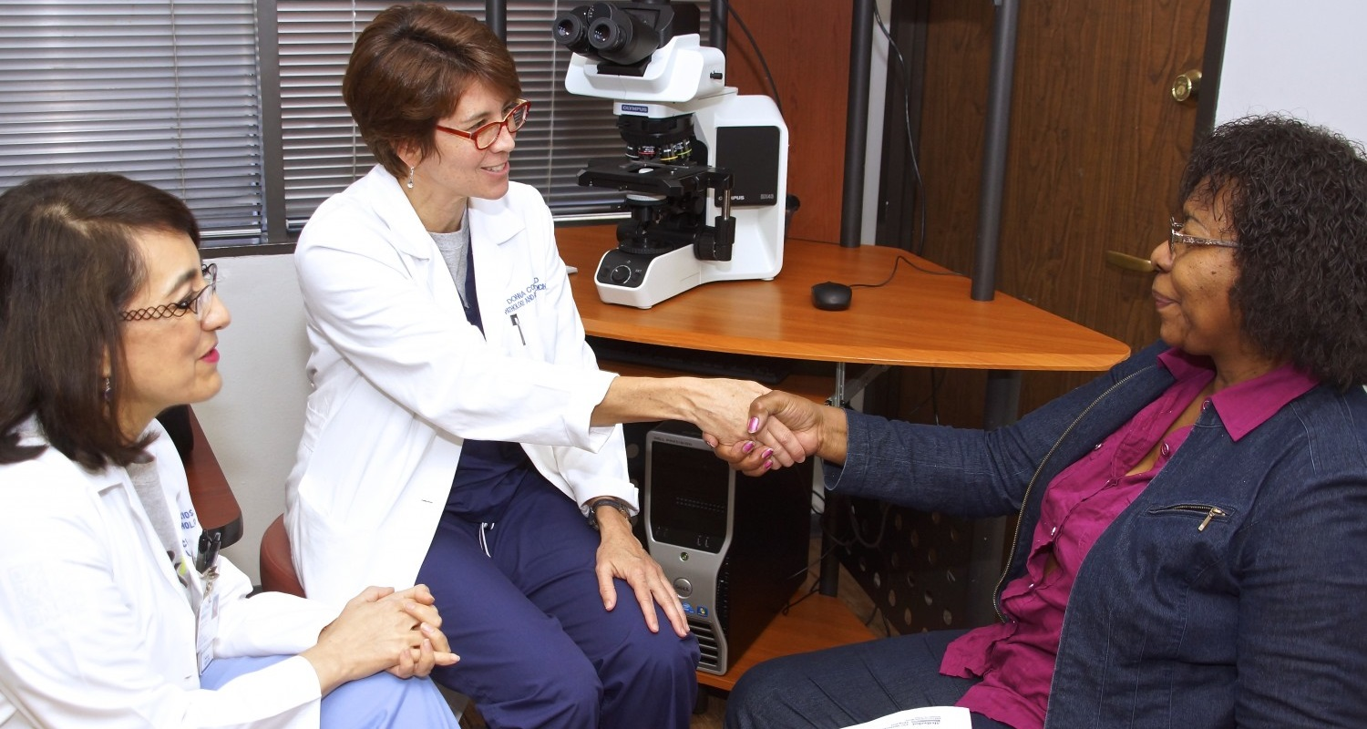
See, Test & Treat connects communities with their health care providers
Notes:
That brings us to the third major impact:
See, Test & Treat connects communities with their health care providers
In the communities we serve, many more people report that they don’t have a regular primary care physician.
For any of the reasons we’ve already touched on, too many people live without regular preventive care.

Slide 19
See, Test & Treat connects communities with their health care providers
Community members have the chance to…
Come to a hospital or clinic
Connect face to face with doctors
Schedule follow-up care
Notes:
Through See, Test & Treat,
Community members have the chance to…
Come to a hospital or clinic
Connect face to face with friendly doctors
And schedule follow-up care
So we’re engaging them with the health care resources in their own communities.

Slide 20
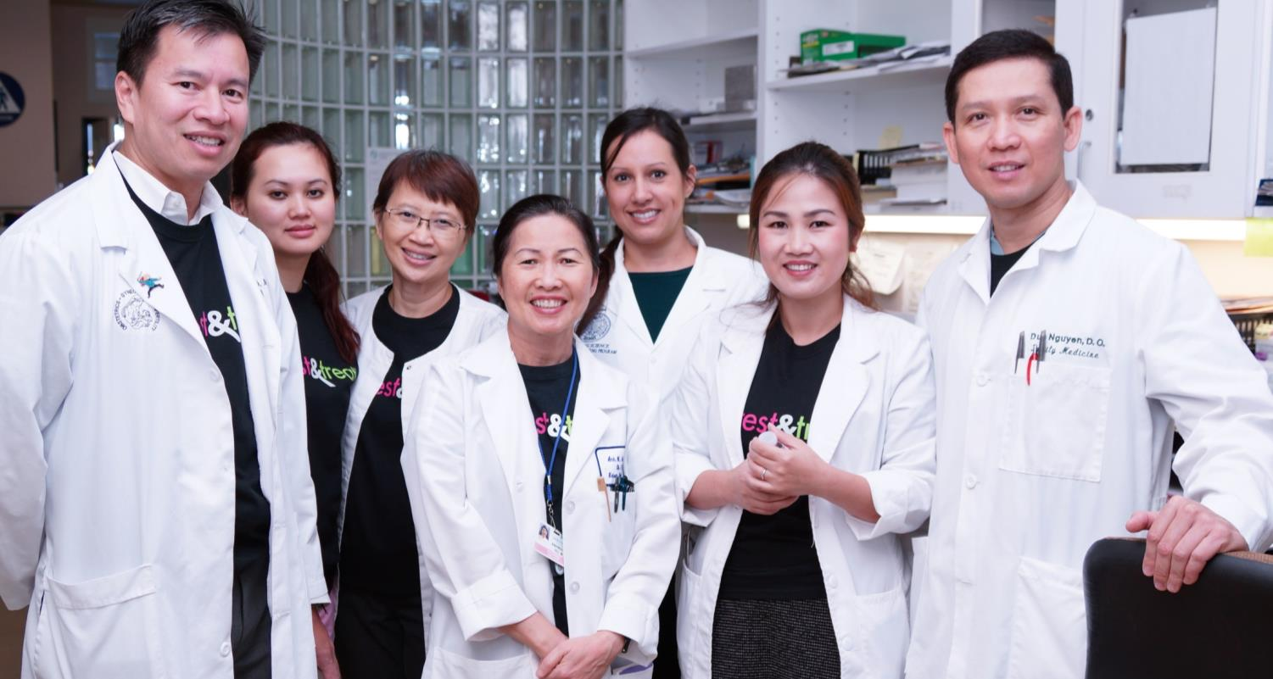
Leadership from Pathology
Patients learn who pathologists are
Residents gain experience with the public
Clinicians see pathologists with patients
Administrators see pathologists lead
Notes:
In addition to its many impacts on women, families and communities,
See, Test & Treat is also a great example of leadership from the field of pathology.
That’s important because as health care evolves,
pathologists will play an increasingly forward role in caring for and communicating with patients,
as well as collaborating in health care teams.
Every See, Test & Treat program begins with a pathologist who
recognizes the need in his or her community,
champions the program,
and rallies a host of partners to deliver patient care.
Everyone who participates in a See, Test & Treat comes away with a greater understanding of pathologists’ vital role in community medicine:
Patients learn who pathologists are, what we do, and who to call for a second opinion
Residents gain experience engaging with patients and the public
Other Clinicians see how pathologists can connect with their patients
Health Care Administrators see pathologists playing leadership roles

Slide 21

What’s the
next level?
Notes:
See, Test & Treat is ready to achieve so much more.
Its design has been tested and refined by pathologists across the country;
its success has been replicated in all kinds of communities and institutional settings.
So what’s the next level?

Slide 22
We’re ready to do
so much more.
Programs Across America
25
by 2017
11
in 2015
Notes:
The next step is to achieve greater scale and impact.
CAP Foundation implemented 11 See, Test & Treat programs in 2015.
Our near-term goal is to scale up to 25 programs by 2017.
Beyond 2017, the goal grows more ambitious: CAP Foundation will actively support 25 See, Test & Treat programs each year but will encourage them toward achieving sustainable funding support from within their own communities.
Because the program delivers real impact on critical community health issues,
it will be a strong candidate for local foundation and institutional funding, as well as individual donor support.
As individual See, Test & Treats achieve self-sufficiency, they will free up CAP Foundation grant funding to launch new See, Test & Treat programs in other cities.
Over time, the See, Test & Treat program will grow to achieve a lasting presence in many communities across America.

Slide 23
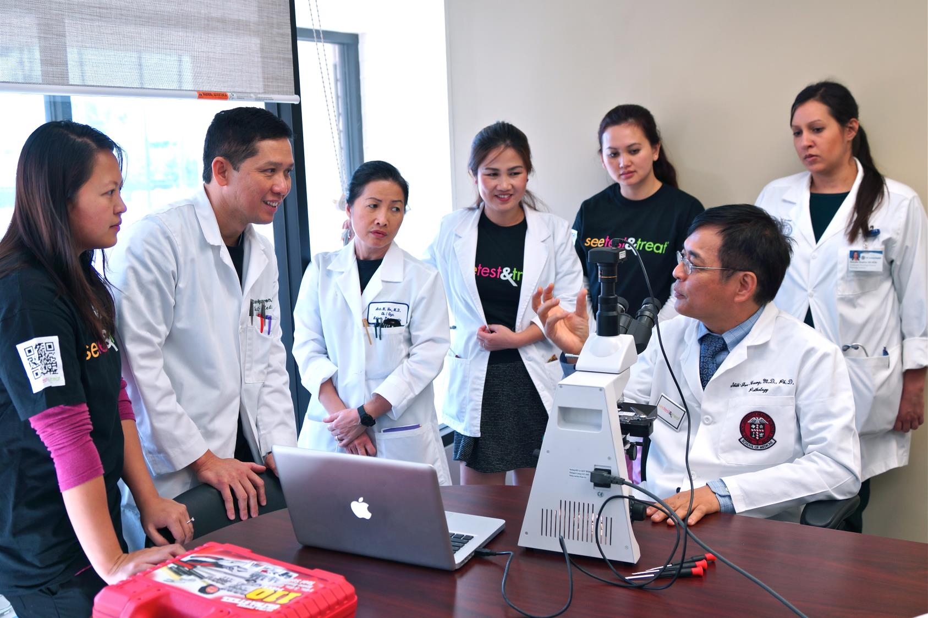
But it all depends
on your support.
Notes:
But this vision depends on your support.
Philanthropic investment will determine how far See, Test & Treat can reach—and how quickly.

Slide 24
Your gift to
See, Test & Treat means:
Another community we can reach
Hundreds more women and family members we can serve
More early diagnoses that save lives
Notes:
Every See, Test & Treat program requires an investment on the scale of $50,000,
which includes the grant funding for the program site and CAP Foundation’s intensive staff support and coordination.
Every $50,000 that we can secure means the difference between a new See, Test & Treat program happening—or not.
When you help make a See, Test & Treat program possible, that means:
Another underserved community gets more engaged with high-quality health education and prevention
Hundreds more women gain access to screenings and health care they need
Early diagnoses save women’s lives and change their families lives for an entire generation

Slide 25
Give to
See, Test & Treat
today!
Notes:
It all begins with the leadership of America’s pathologists—and it depends on your support. Give to See, Test & Treat today!

